Slide 1

The Upside-Down World of Active Directory Auditing
The Upside-Down World of Active Directory Auditing

Slide 2


The Upside-Down World of Active Directory Auditing
The Problem:
While you might know who domain admins are, you very likely do not know where they are logged in….

Slide 3

The Upside-Down World of Active Directory Auditing
The Problem:
Meanwhile, Red Team needs a way to hunt down privileged users efficiently

Slide 4



The Upside-Down World of Active Directory Auditing
The Solution:
BloodHound

Slide 5
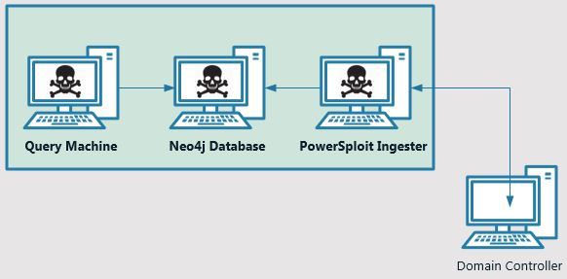
The Upside-Down World of Active Directory Auditing
The Solution:
BloodHound is essentially a suite of multiple tools used in concert to present graphical representations of data that most red team engineers need to find through manual processes

Slide 6
The Upside-Down World of Active Directory Auditing
The Install:
At a high level, installing and using BloodHound involves the following steps:
Download and install your database (Neo4j)
Download the powershell ingestor component (from GitHub)
Run powershell script to import ingestor module, get AD data and import into your Neo4j (with credentials to your db)
Run the BloodHound application to search and beautify results from Neo4j

Slide 7
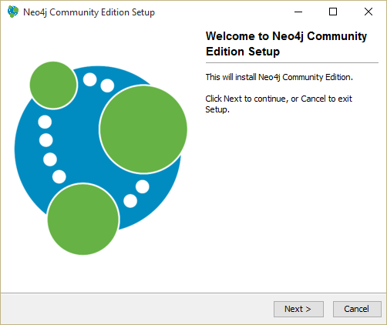
The Upside-Down World of Active Directory Auditing
The Install:
Installing Neo4j…so simple (get community edition from neo4j.com

Slide 8
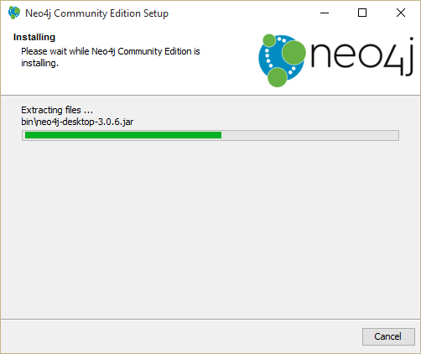
The Upside-Down World of Active Directory Auditing
The Install:
Installing Neo4j…so simple (get community edition from neo4j.com

Slide 9
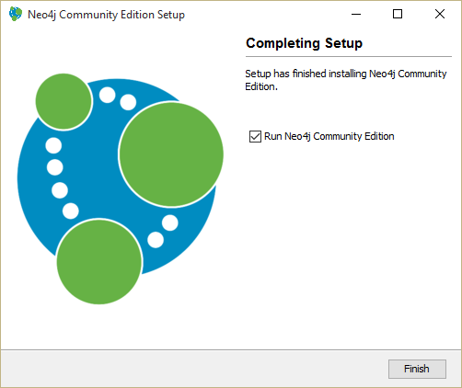
The Upside-Down World of Active Directory Auditing
The Install:
Installing Neo4j…so simple (get community edition from neo4j.com

Slide 10
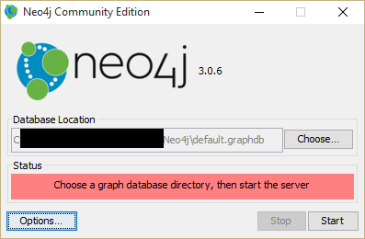
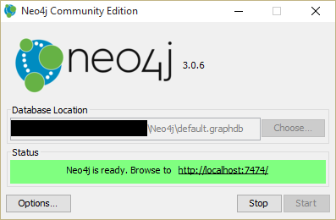
The Upside-Down World of Active Directory Auditing
The Install:
Installing Neo4j…so simple (get community edition from neo4j.com

Slide 11
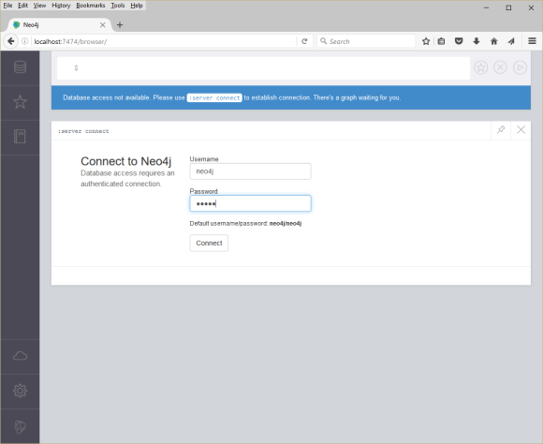
The Upside-Down World of Active Directory Auditing
The Install:
Installing Neo4j…so simple (get community edition from neo4j.com

Slide 12
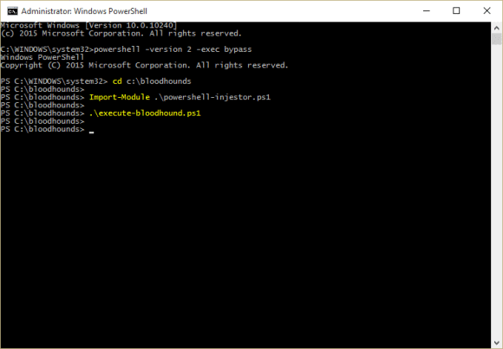
The Upside-Down World of Active Directory Auditing
The Install:
Running the powershell ingestor…again super easy
Steps here:
Launch PowerShell: powershell –version 2 –exec bypass
Import the module: Import-Module .\powershell-ingestor.ps1
Execute your BloodHound script: .\execute-bloodhound.ps1
Contents of BloodHound Script…
Get-BloodHoundData | Export-BloodHoundData -URI http://localhost:7474/ -UserPass "neo4j:neo4j"

Slide 13
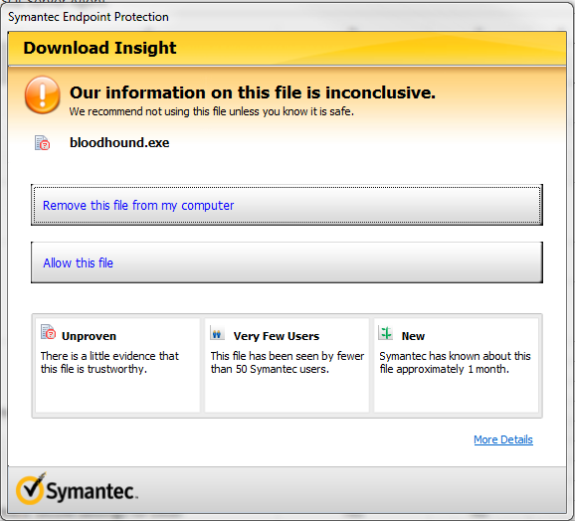
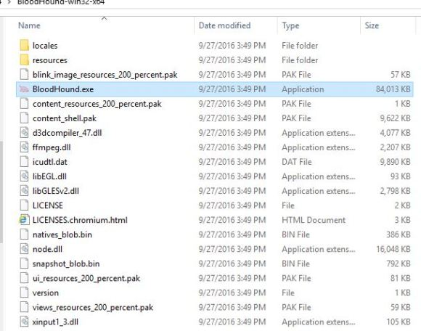
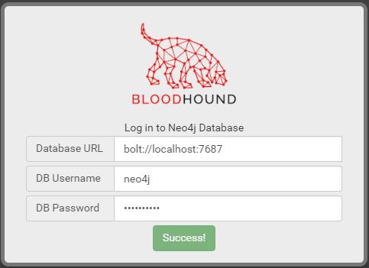
The Upside-Down World of Active Directory Auditing
The Install:
Having fun with the data!

Slide 14

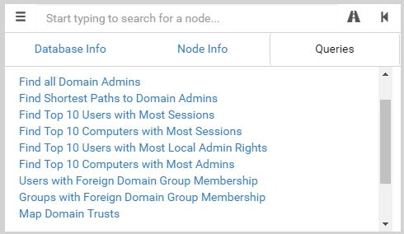
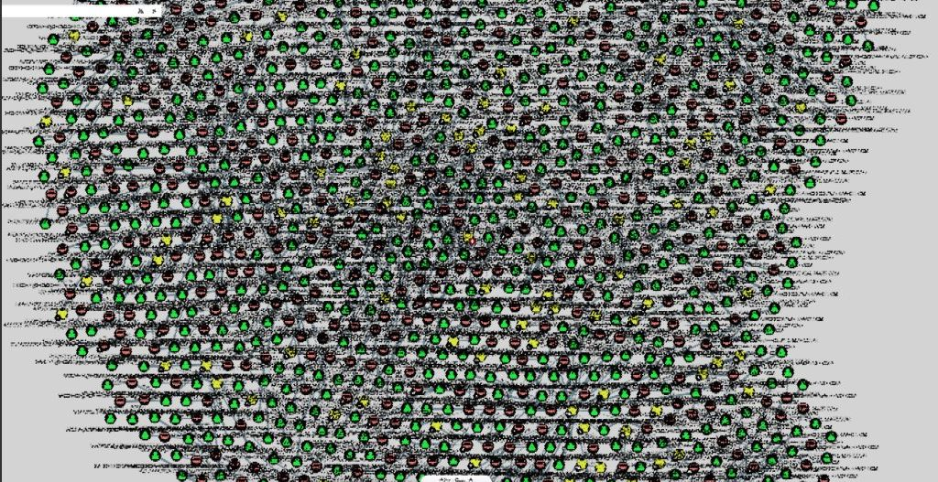
The Upside-Down World of Active Directory Auditing
The Use:
Having fun with the data!

Slide 15
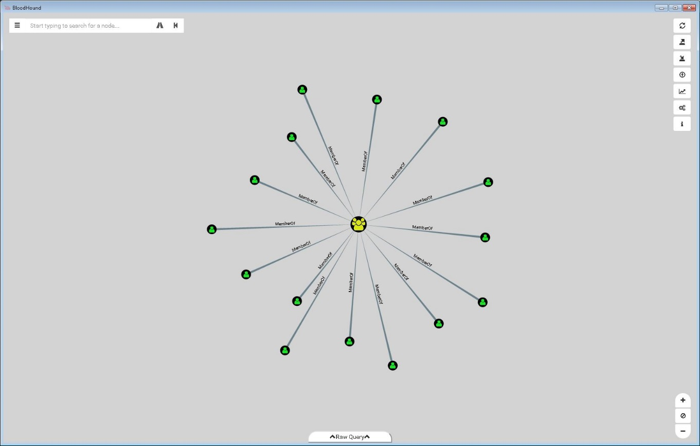
The Upside-Down World of Active Directory Auditing
The Use:
Domain Admin Group Memberships…yeah so what?

Slide 16
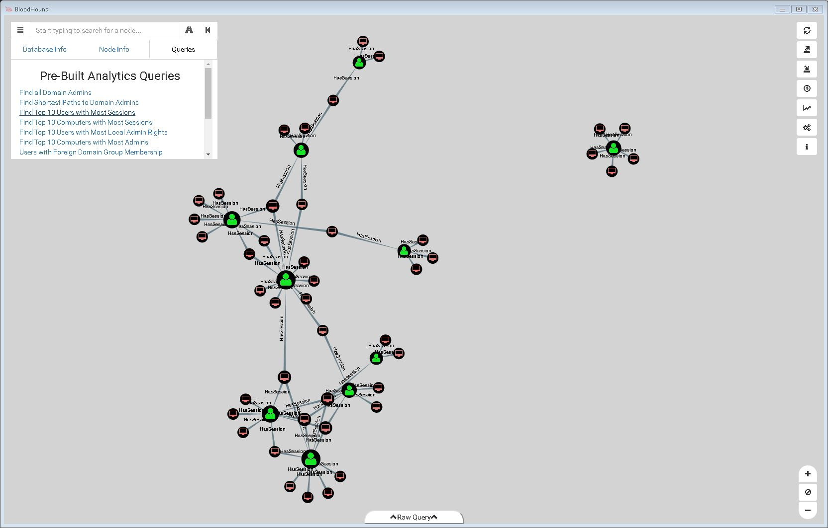
The Upside-Down World of Active Directory Auditing
The Use:
How about top 10 users with most sessions?

Slide 17
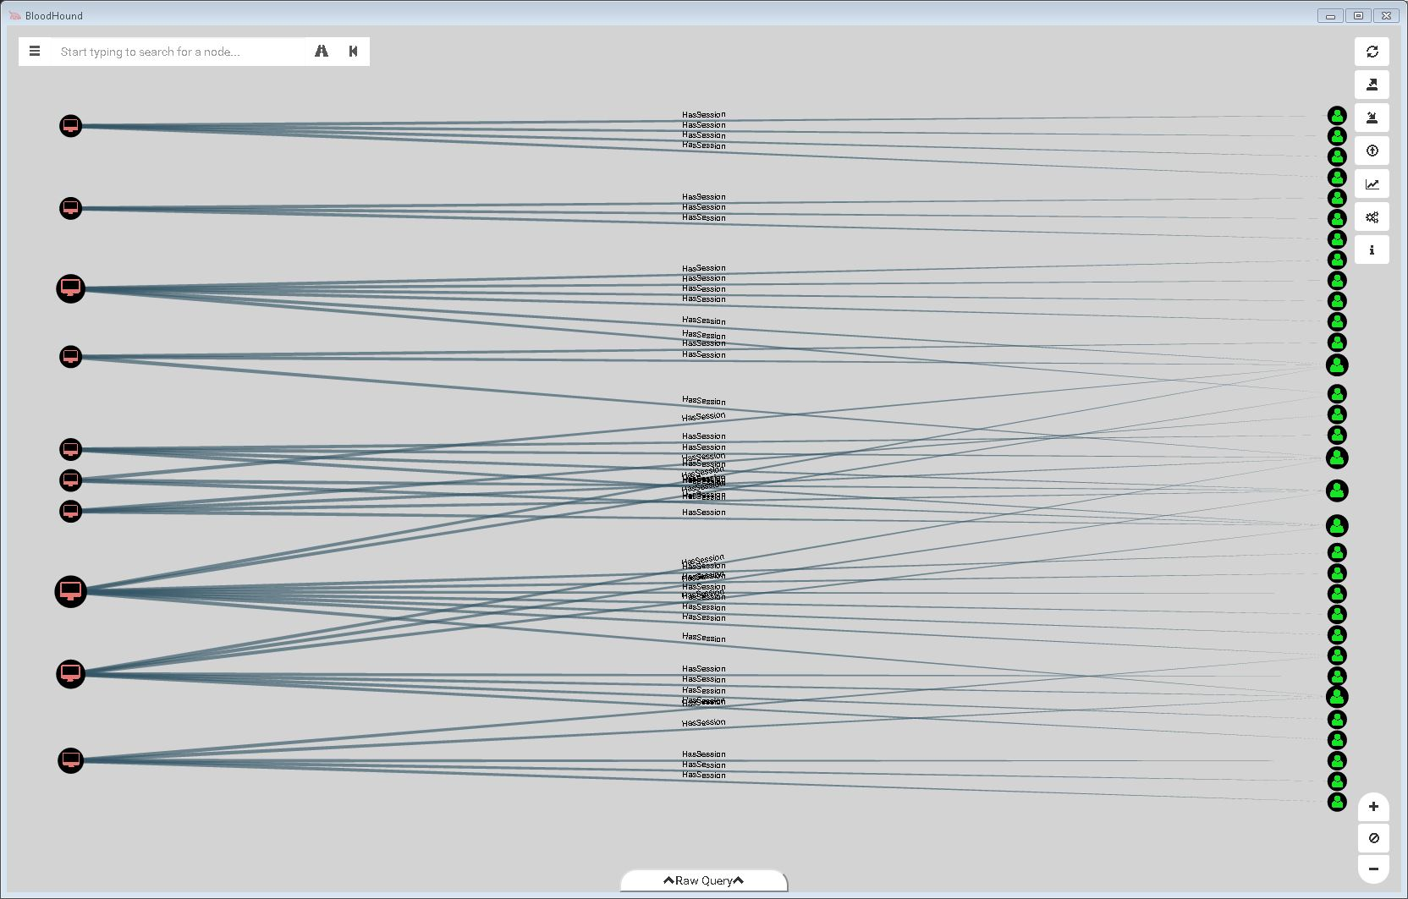
The Upside-Down World of Active Directory Auditing
The Use:
How about top 10 computers with most sessions?

Slide 18
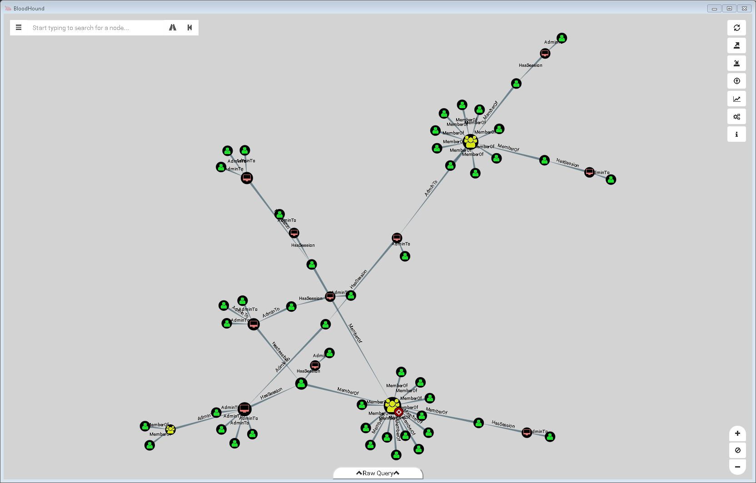
The Upside-Down World of Active Directory Auditing
The Use:
And shortest path to DA?

Slide 19
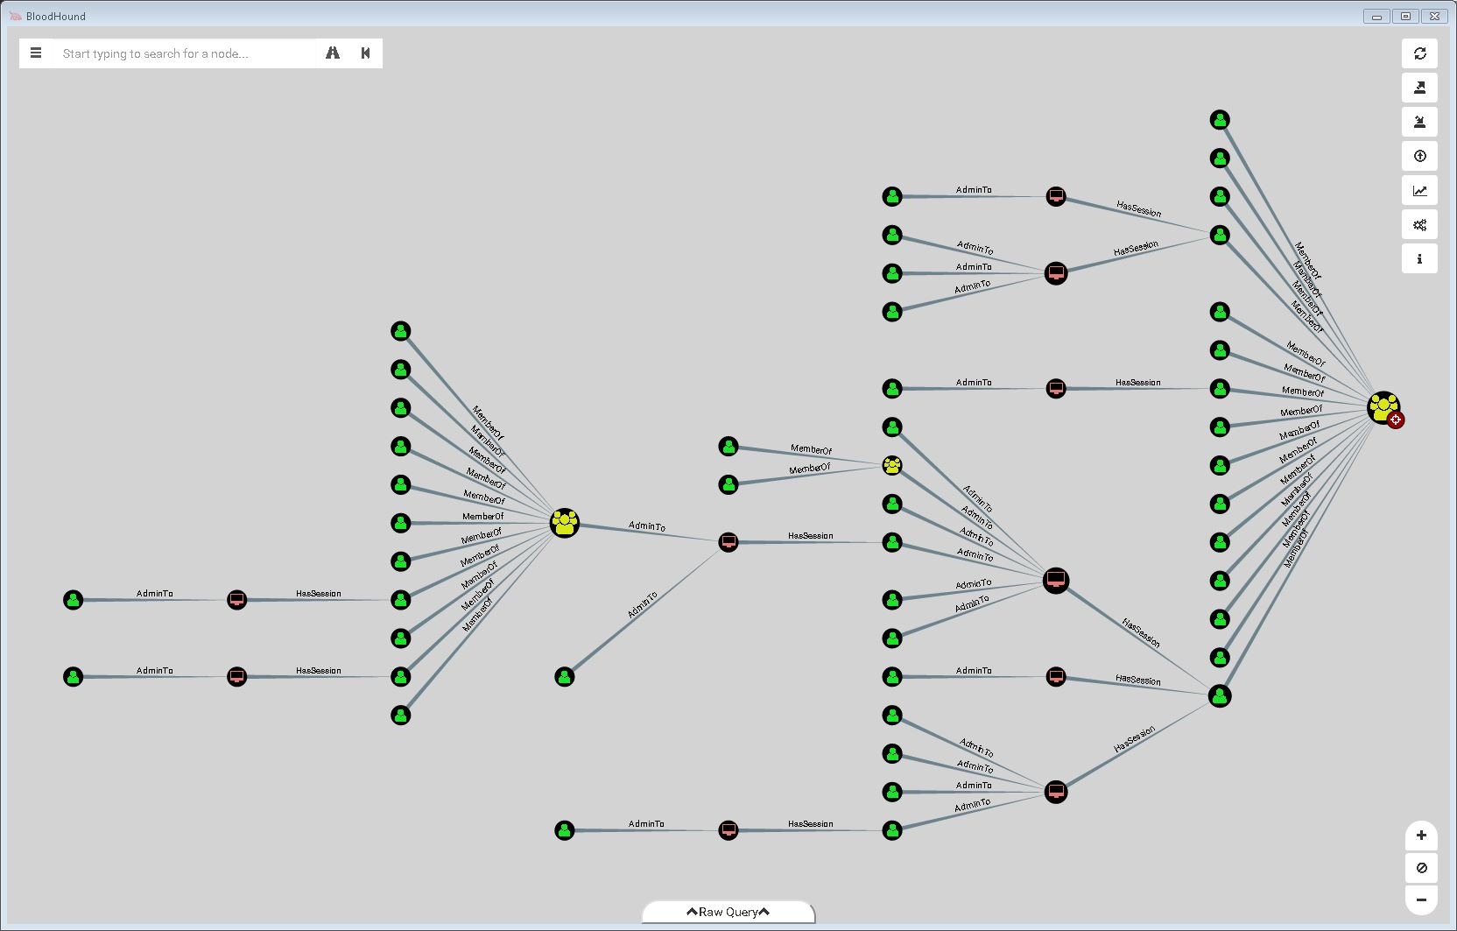
The Upside-Down World of Active Directory Auditing
The Use:
And shortest path to DA?
THIS IS A SERVICE ACCOUNT

Slide 20
The Upside-Down World of Active Directory Auditing
The Use:
Additional Details:
My Twitter: @thedefensedude
My online tutorial for BloodHound:
https://thedefensedude.wordpress.com
Andy’s Site:
https://wald0.com
BloodHound Github:
https://github.com/BloodHoundAD/BloodHound
An awesome video on Active Directory Real Defense for DAs by Jason Lang
https://youtu.be/uccM2xtE5SA

